Slide 1

Real-Time Synchronization of C model with UVM Testbench
Kirtan Mehta
onsemi
Notes:
Hello everyone, My name is Kirtan Mehta, employed at onsemi. In this presentation , I will be talking about the paper “Real-Time Synchronization of C model with UVM Testbench” published at DVCON US 2025.

Slide 2
MOTIVATION
C/C++ Models
Crucial for handling intricate computations.
Serving as golden reference models for Verification and Post-silicon Validation.
Cmodels integrated into UVM Predictor/Scoreboards through DPI-C
Requires manual intervention and Code development.
Leading to inefficiencies and prone to human errors.
MORE AUTOMATION BETWEEN MODELS
Notes:
The motivation behind this paper, understanding the importance of Cmodels in the ASIC Verification as golden reference models. These models are integrated into UVM predictors/Scoreboards through DPIC. To implement this, it requires lot of DPIC code within the UVM components, increasing the length of code, making it inefficient and prone to human errors.

Slide 3
SOLUTION
Updating C/C++ Model registers and memories based on Real time traffic on Interface.
Embedding DPI-C functions into UVM RAL adapters.
Reduces the need for manual synchronization.
Enhances the accuracy and efficiency of the verification process.
UVM TB ARCHITECTURE AND DATAFLOW
Notes:
This can be resolved by updating the Cmodel registers and memories based on Real time traffic from the BUS interface.
One of way to implement this is to add DPIC functions within the RAL adapters. This not only updates the RAL registers and memories but also update the Cmodel registers and memories.
Reduces the need for manual synchronization.
Enhances the accuracy and efficiency of the verification process.

Slide 4
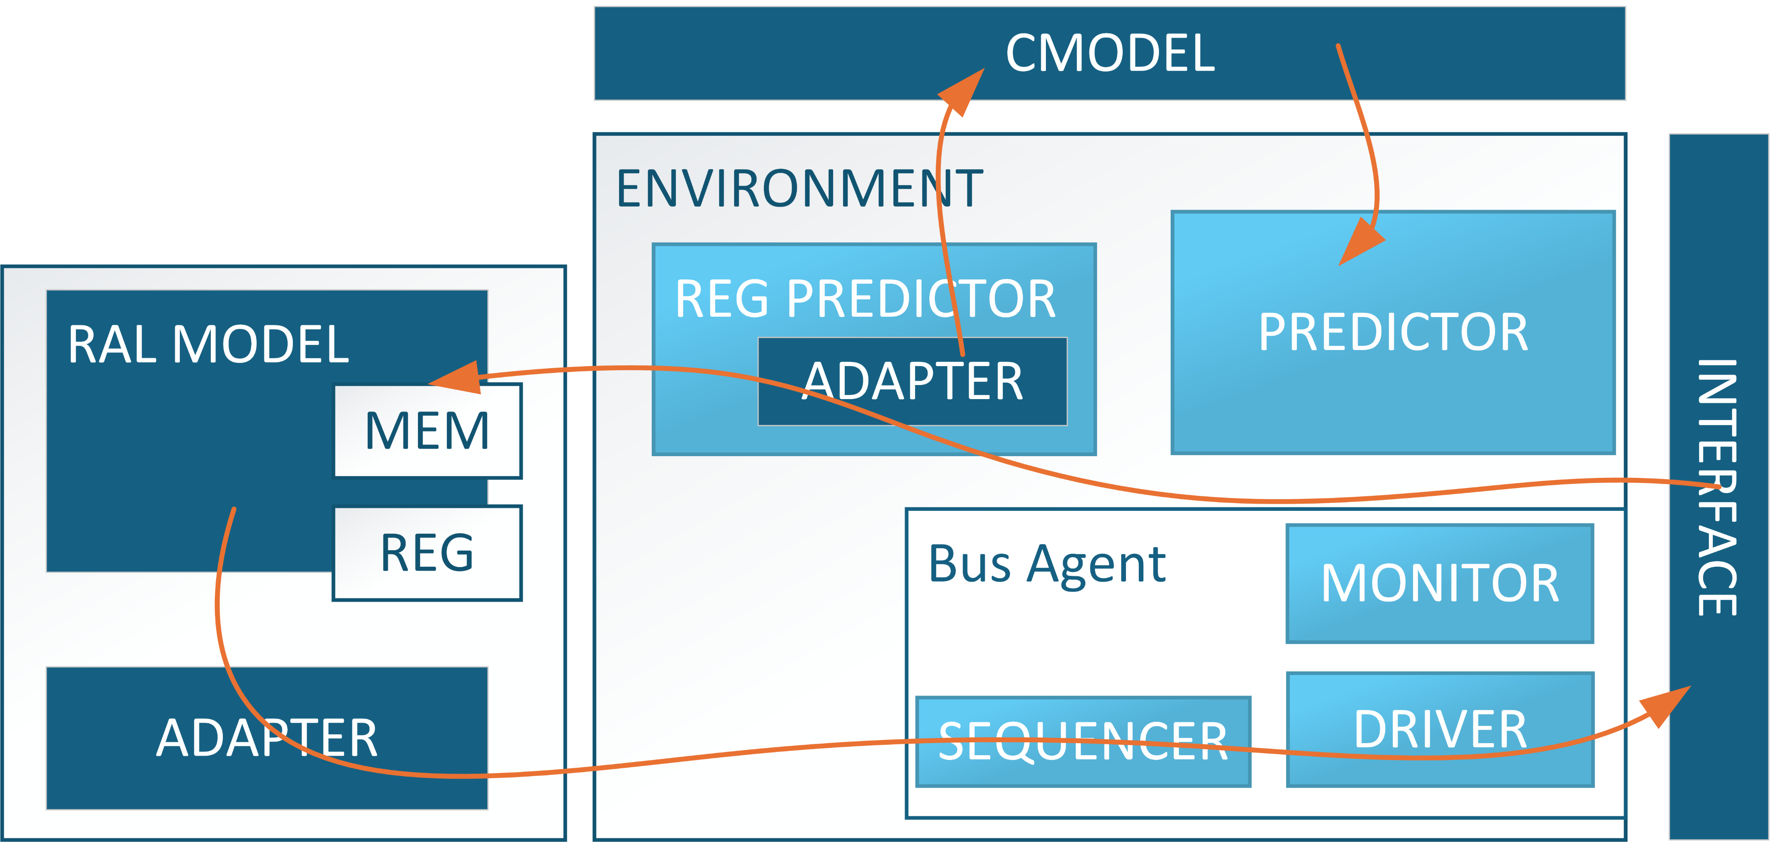
UVM TESTBENCH ARCHITECTURE
Notes:
Here is the UVM TB architecture. As you can see the RAL model can generate the transactions through adapter and send it over to the interface. Reg predictor also updates the RAL registers and memories based on interface traffic. The DPIC functions can be implemented inside to RAL adapters to send the address, data and all the relevant info the Cmodel to keep the cmodel in sync with TB. The UVM predictor would no longer need to provide any info cmodel as it will be up to date to TB and design. Thus predictor can excute Cmodel and receive the golden reference for comparison.

Slide 5
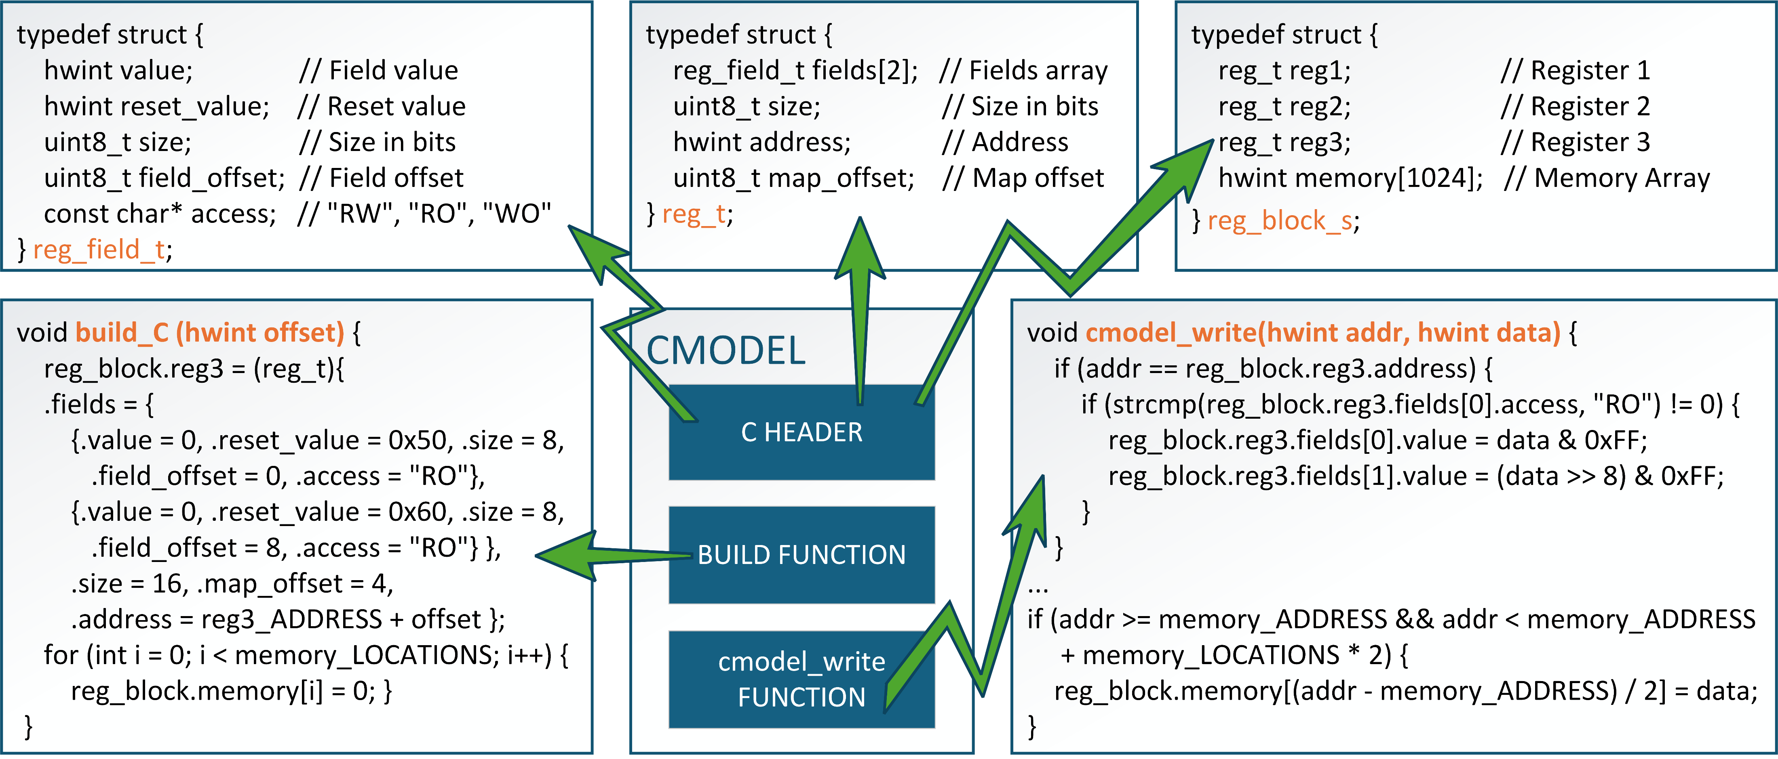
C/C++ IMPLEMENTATION
Notes:
The Cmodel implementation requires some identical structure to the RAL to make it easier to implement. As we can see, we have created Register, reg fields and reg block structures which could be reused within the Cmodel to mimic RAL and design. Build function initializes the Cmodel registers and memories by allocating space and defaulting the values..
Cmodel write function takes in Address and data as input and based on Register configuration/access, updates the data. Here Reg3 with 2 reg fields and RO access is shown as example.

Slide 6
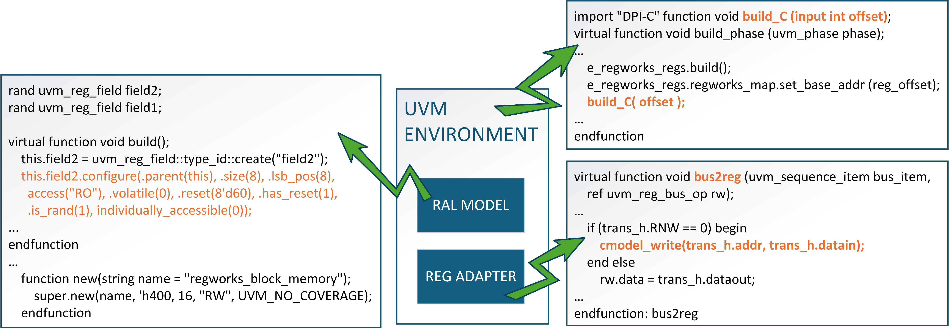
UVM IMPLEMENTATION
Notes:
Here is the UVM side of implementation, in the UVM environment, we are calling the build function in C through DPIC during build_phase.
The bus2reg function, when write happens on the Bus interface, it calls the cmodel_write function and provides the address and data which are seen on the interface.

Slide 7
ADVANTAGES
Automation and Efficiency: Embedding DPI-C functions into UVM RAL adapters reduces manual effort and potential human error.
Real-time Updates And Monitoring: Ensures continuous updates and synchronization between the C model and testbench for accurate and efficient verification.
Scalability: Handles complex operations like burst via front-door memory transactions, suitable for block-level and SoC verification environments.
Consistency: Mirrors the register and memory structure of the UVM RAL model, enhancing uniformity and reliability across the codebase.

Slide 8
DRAWBACKS
Complex Integration:
Integrating DPI-C functions into RAL adapters requires common definitions for Cmodel and RAL.
Continuous synchronization with evolving designs can add complexity.
Performance Issues:
Real-time updates may increase TestBench simulation time.
Larger TB might require additional support to handle such automation.

Slide 9
Questions

